Slide 1

A Family Business Moving to a New Location Capstone Project, IBM Data Science Professional Certificate - The Battle of Neighborhoods (Week 2)
Muhammad Faizan Siddiqui (09-May-2020)

Slide 2
Introduction

Slide 3
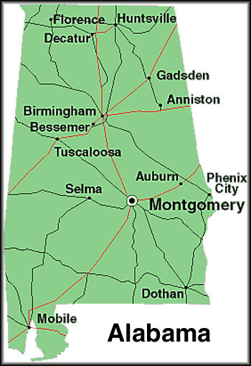
Background
A Huntsville, Alabama based health-and-fitness business
All segments of the business facing sharp decline in revenue
There seems to be no silver lining in the short term

Slide 4
Problem
The family is considering relocating to a different city
looking for the city with relatively requires low investment in real estate
They would like to remain on the South or East side
Concerned about the changes in the weather

Slide 5
Approach
Create list of states on the South and East side
1
Shortlist those with similar weather conditions using KMeans Clustering.
2
Select states from these state with average low-cost of real estate
3
Finally, determine the cities that may have more potential for health-and-fitness business
4

Slide 6
Data

Slide 7
Requirements and Sources
Download
Download census regions data to create list of states on the South and East side
Web Scrape
Web scrape state-wise average weather data.
Download
Download real estate median home value dataset from Zillow via Opendatasoft: Data Network.
Use
Use Foursquare API to determine health-and-fitness related venues within the selected cities.
Download
Download list of cities from United States Cities Database (basic version) from SimpleMaps.

Slide 8
Data cleansing and feature selection
Loaded data from data sources mentioned earlier
Retained only relevant features for the analysis
We standardized all column names
We also removed any non-ASCII characters from
All column names, and
Certain columns needed for joining data frames

Slide 9
Methodology

Slide 10
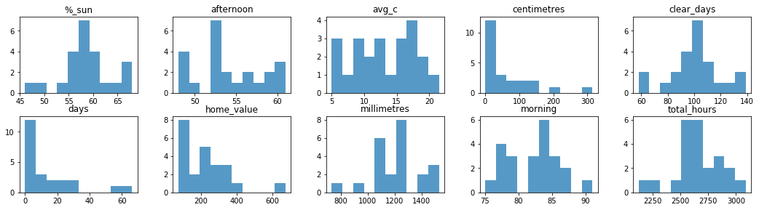
Histogram to identify any irrelevant features for clustering
There were outliers within the features, but all features seem to be significant for the job

Slide 11
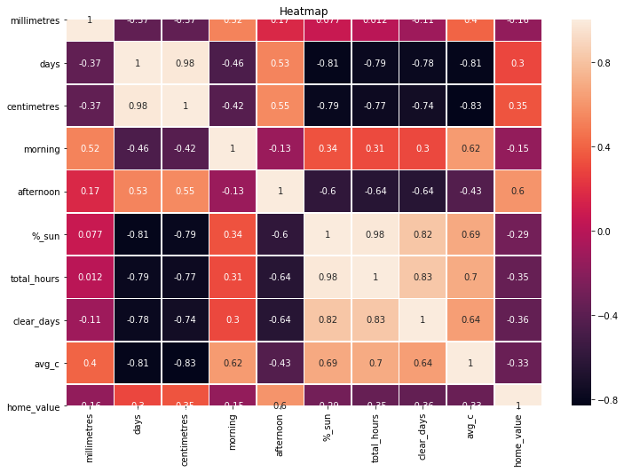
correlation within features is not a major problem for Clustering There is a strong relationship between some attributes

Slide 12
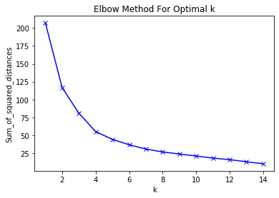
we used Elbow method to find optimal value for ‘k’ (=4)

Slide 13
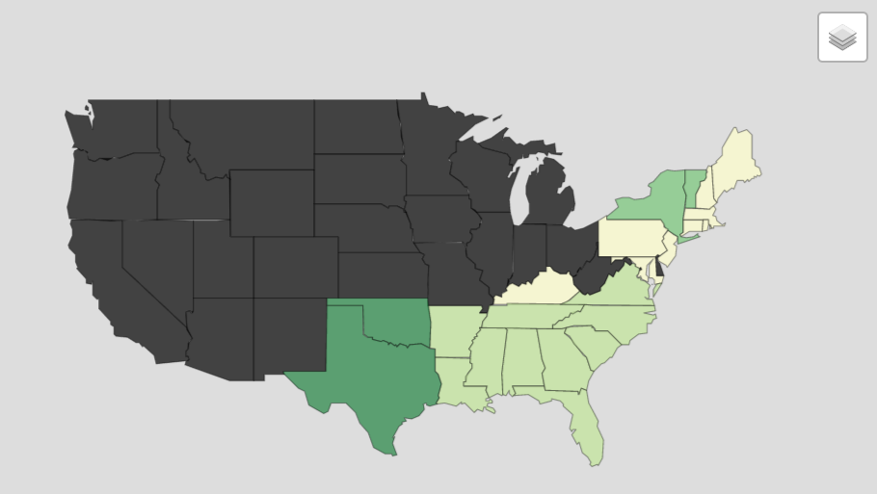
choropleth map using a folium library to visually depict the cluster of states based on the weather data selected top 4 states where median house value was the lowest

Slide 14
Results

Slide 15
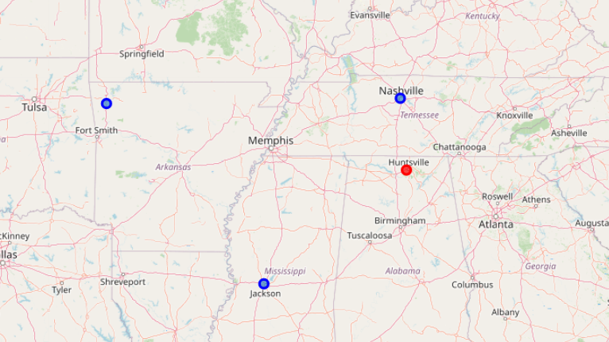
Nashville, Fayetteville and Jackson

Slide 16
Discussion

Slide 17
Discussion
Assumed the business indeed required to be relocated and there is no other option
A very simplistic approach to a very complex business problem
Only considered house median values as the dataset was freely available
Always tried to minimize scope of work and usage of Foursquare API, being free version
Shortcomings should be overcome for a commercially viable solution

Slide 18
Conclusion

Slide 19
Conclusion
Objective
To help a poorly performing family business in relocation
Under several constraints
We identified three cities that met the stated requirements

Slide 20
Thank you!

